Slide 1
4COSCO11C.2 Web Design and Development
Introduction to Web Technologies
Week 1 | Janani Harischandra

Slide 2
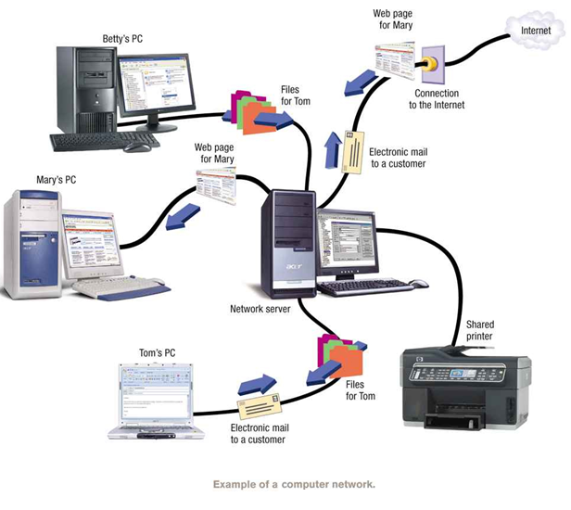
Computer Network
A computer network is a group of computers and other computing hardware devices that are linked together through communication channels to facilitate communication and resource-sharing among a wide range of users.

Slide 3
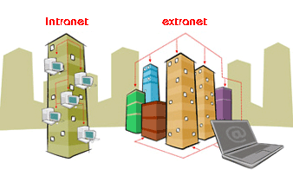
Types Of Networks
Intranet
A private computer network
Information is securely transferred among group of people
(E.g.: Share organizational information among employees)
Extranet
Same as Intranet but,
Share part of internal information or operations with outsiders
(E.g.: Share part of organizational information with vendors, suppliers…etc)
http://education-portal.com/academy/lesson/intranet-and-extranet-comparing-information-and-data-dissemination.html#lesson
Internet ?
Notes:
IIT has it own intranet – HR systems

Slide 4

The Internet
The Internet is a
worldwide collection of computer networks
cooperating with each other
to exchange data
using a common software.
History
Connecting computers at four universities across the country during 1969
Known as ARPAnet ( Advanced Research Projects Agency in United states.
Read more:
http://www.computerhistory.org/internet_history

Slide 5
Video
How the internet works
http://www.youtube.com/watch?v=Jj6EHgSsx_U
How Does the Internet Work
https://www.youtube.com/watch?v=i5oe63pOhLI
History of the Internet
http://www.youtube.com/watch?v=rRpcSjck4wo

Slide 6
Advantages and Disadvantages of the Internet
Advantages of the Internet
Faster Communication
Rich Information Resources
Infinite Education
Entertainment for Everyone
Social Networking and Staying Connected
Online Services and E-commerce

Slide 7
Advantages and Disadvantages of the Internet
Disadvantages of the Internet
Theft of Personal Information
Spamming
Malware Threats
Age-inappropriate Content
Social Isolation, Obesity, and Depression
Advantages and Disadvantages of the Internet

Slide 8
Internet Communication
Protocols
Addressing
IP Address
Domain Name
URL

Slide 9
Protocol
There are rules governing how data is transferred over networks, how they are compressed, how they are presented on the screen and so on.
These set of rules are called protocols.
Examples :
HTTP - Hypertext Transfer Protocol
HTTPS - Secure Hypertext Transfer Protocol
TCP/IP – Transmission Control Protocol / Internet Protocol
FTP – File Transfer Protocol

Slide 10
Internet Addressing
An Internet Protocol address (also known as an IP address) is a numerical label assigned to each device (e.g., computer, printer) participating in a computer network
Every computer / device connected to the Internet has a unique identity.
You can use any of the following two ways:
(IP) address
a four-part number string
Example
192.168.0.128
domain name
a text
Example
abc.iit.lk
Notes:
To send data through internet -> you need to have an address

Slide 11
IP Address
Every machine on network has a unique identifying number, called an IP Address.
A typical IP address looks like this(ipv4): 216.27.61.137
The format of an IP address is a 32-bit numeric address written as four numbers separated by periods
Notes:
The Internet has run out of Internet addresses... sort of. Perhaps you've heard the news: the last blocks of IPv4 Internet addresses have been allocated.
The transition from IPv4 to IPv6 is likely to be rough, though. Most people are unfamiliar with IPv4 and IPv6, much less the potential impact the switch to IPv6 may have on their lives.
IP – interner protocol

Slide 12
Domain Names
A name that identifies a computer or computers on the Internet.
Advantage:
Numeric addresses are difficult to work with
Extremely difficult to remember as humans
Example
http://10.0.7.200:8080 Vs. http://moodle.sliit.lk
Disadvantage:
Unable to generate meaningful and unique names for all devices in the Internet

Slide 13
Levels of Domain
Domain names are organized in a hierarchical manner.
Top Level Domain (TLD) : Last part of the Domain name
e.g. : org is TLD of www.wikipedia.org
Second Level Domain: Name directly to the left of TLD
e.g. : wikipedia is SLD of www.wikipedia.org
Third Level Domain: Name directly to the left of second level Domain
e.g. : mail is SLD of mail.google.com
Notes:
Organizational Hierarchy
Domain Purpose
com Commercial organizations
edu Educational institutions
gov Government institutions
mil Military groups
net Major network support centers
org Nonprofit organizations and others
int International organizations
Geographic hierarchy
In the geographic hierarchy, each country is assigned with two letter codes. These codes are used to identify countries.
For example, take the domain name images.google.com
Here, the “.com” is the top-level domain. It is called as tld in short. This is the next component in the DNS hierarchy. A TLD can have many domains under it. For example, a .com tld can have linux.com, centos.com, ubuntu.com, etc.
Sometimes, there is a second level hierarchy to a tld. They deal with the type of entity intended to register an SLD under it. For example, for the .uk tld, a college or other academic institution would register under the .ac.uk ccSLD, while companies would register under .co.uk.

Slide 14
Domain Name System
Domain Name System (DNS) is a database system that translates a computer's fully qualified domain name into an IP address.
www.amazon.com
207.171.166.48
DNS Resolution

Slide 15
DNS resolution
Translating the name into the IP address is called “resolving the domain name” or “DNS resolution”.
Resolution occurs when a client queries a name server to obtain the IP address with which it wants to connect.
If a name server in the local domain cannot resolve a client's request, it queries other servers to locate a server that can.

Slide 16
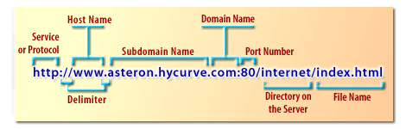
Uniform Resource Locator
URL is the unique address for a file that is accessible on the Internet.
http://www.seopearl.com/internet-web-technologies/module4/uniform-resource-locator.php
Notes:
URI stands for uniform resource identifier and URL stands for uniform resource locator.
URLs are a subset of URIs. That means all URLs are URIs. It doesn't work the opposite way though.

Slide 17
The Internet’s Client/Server Architecture
Server: Service providers
Computer program or machine that provide services to (Web Services or FTP services) to other programs or users (machines).
Client: Service requesters
Computer program or machine that request the services from servers.
Request
Respond
Client/server describes the relationship between two computer programs in which one program, the client, makes a service request from another program, the server, which fulfils the request

Slide 18
Client-Server Architecture contd..
Client-Server Architecture
2-Tier Architecture
3-Tier Architecture
N-Tier Architecture

Slide 19
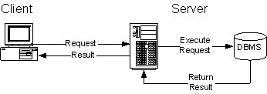
2-Tier Architecture
A two-way interaction in a client/server environment, in which the user interface is stored in the client and the data are stored in the server.
The application logic can be in either the client or the server.
basic two-tier architecture
http://edn.embarcadero.com/article/10343

Slide 20
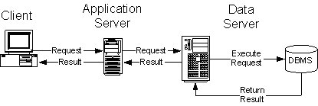
3-Tier Architecture
A three-way interaction in a client/server environment, in which the user interface is stored in the client, the bulk of the business application logic is stored in one or more servers, and the data are stored in a database server.
basic three tier architecture
http://edn.embarcadero.com/article/10343

Slide 21
Web Browsers
Software application for retrieving, presenting, and traversing information resources on the World Wide Web.
Information Resources : Images, videos, and other piece of content. Hyperlinks present in resources enable users to easily navigate their browsers to related resources.
URL : (Uniform Resources Locaters) are used to identify the location of the resources in the Internet.

Slide 22
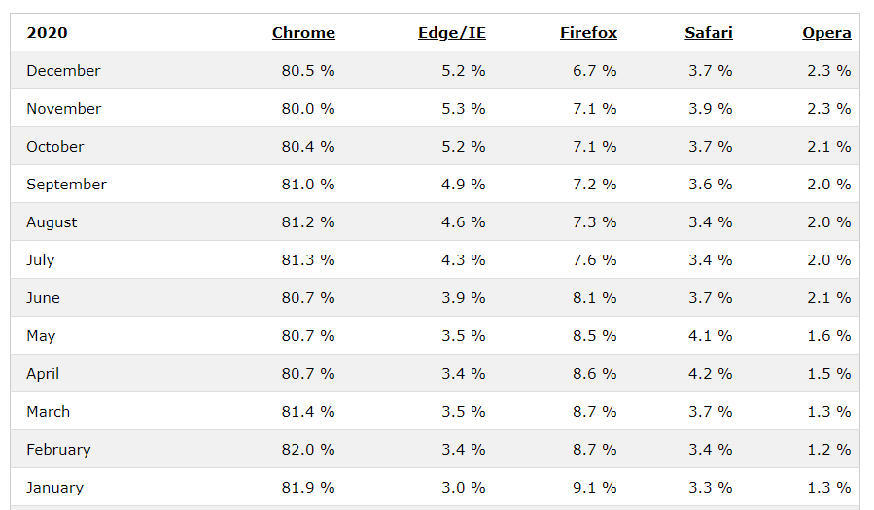
Web Browsers
Read more:
http://www.w3schools.com/browsers/default.asp
http://www.smashingmagazine.com/2007/11/21/web-browsers-you-have-never-heard-of/

Slide 23
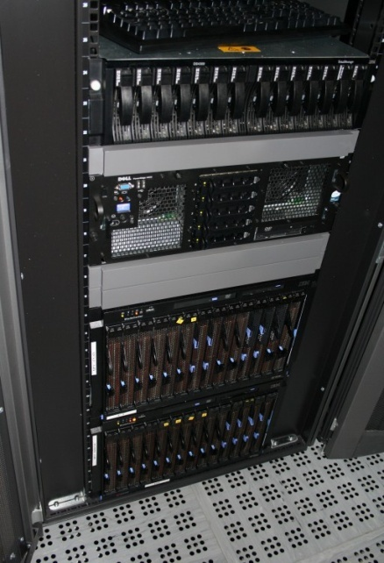
Web Servers
A web Server: computers on the Internet that host websites, serving pages to viewers upon request.
Each Web server has a unique address (IP address) and domain name and Provide services such as Web hosting
Read More:
Comparison of web servers
http://en.wikipedia.org/wiki/Comparison_of_web_servers

Slide 24
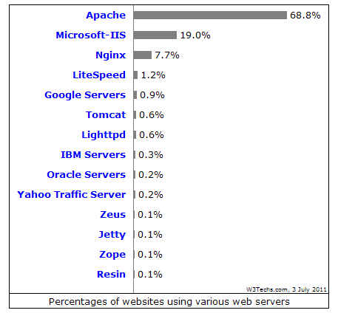



Web Servers
24
Any computer can be turned into a Web server by installing server software and connecting the machine to the Internet
IIS
http://www.iis.net/
Apache
http://www.apache.org/
Tomcat
http://tomcat.apache.org/
Glassfish
https://glassfish.dev.java.net/

Slide 25
Internet Security
When your computer is connected to a network what types of damages could be occurred?
How do you protect the information and network ?
Methods
Firewalls
Proxy Severs
Protocol Tunneling
Virtual Private Networks (VPN)

Slide 26
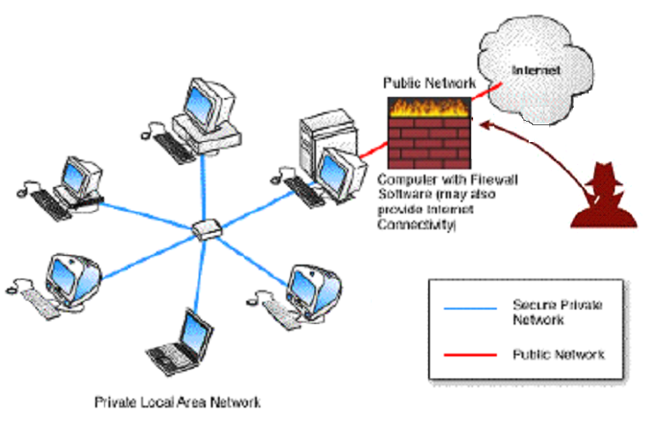
Firewalls
Designed to prevent unauthorized access to or from a private network.
Provide controlled interfaces between zones of differing trust levels through the enforcement of a security policy
Can be implemented in either hardware or software, or a combination of both
Examples:
MacAfee
Cisco ASA 5510 (ASA5510-BUN-K9) Firewall

Slide 27
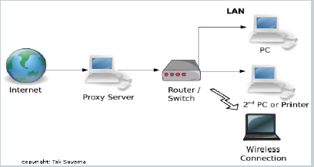
Proxy Server
Proxy server or known as a “Proxy” or “Application level gateway” is a computer (or application program).
Acts as a Gateway between local network and large scale network such as the Internet (or as an intermediary for request from clients seeking information from server).
Advantages
To increase The performance and security
To cache the frequently used/requested file or web pages
To monitor the use of outside resources
Notes:
A firewall and a proxy server are both components of network security. To some extent, they are similar in that they limit or block connections to and from your network, but they accomplish this in different ways. Firewalls can block ports and programs that try to gain unauthorized access to your computer, while proxy servers basically hide your internal network from the Internet. It works as a firewall in the sense that it blocks your network from being exposed to the Internet by redirecting Web requests when necessary.

Slide 28
Summary
Types of Networks
Advantages/ Disadvantages of Internet
Internet Communication – Protocol, IP Addressing, DNS Resolution
Client/Server Architecture
Web Browsers / Web Servers
Internet Security – Firewalls, Proxy Servers

